Slide 1
State of Nevada DIVISION OF INDUSTRIAL RELATIONS WORKERS’ COMPENSATION SECTION
CARDS 205: Intro to CARDS and D-35 for Lawyers
(Claims and Regulatory Data System)

Slide 2
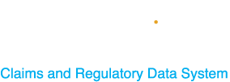
What is CARDS?
CARDS, which stands for “Claims and Regulatory Data System”, is a data collection system for the State of Nevada Workers’ Compensation Section.
For external users in the application, the main function has previously been for indexing claims, running reports, and maintain Insurer and TPA contact information up to date.
With the enhancements to the application, the features will extend to other functionality including, but not limited to; submitting webforms, increased reporting capabilities, processing payments, and improvements to the auditing process.

Slide 3
Overview
Objectives
At the completion of this course, training participants will be able to register an account, have a general understanding of how to navigate through the application, and learn how to submit an Online Complaint through the CARDS application. Also training participants will be able to submit the D-35 webform and understand the Permanent Partial Disability (PPD) Rating Request process.

Slide 4
Registration
User Types
User Permissions and the Role of Account Admin
Filing a D-35 Webform
Complaint Webform
MODULES

Slide 5
CARDS Registration
HOW TO REGISTER A NEW ACCOUNT IN THE CARDS APPLICATION

Slide 6
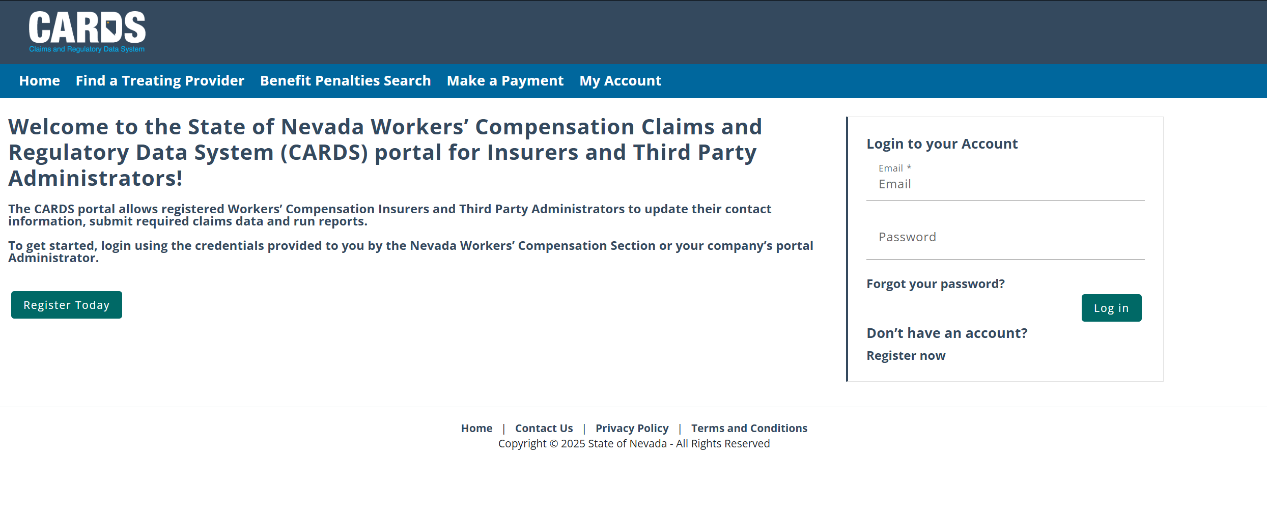
CARDS REGISTRATION
NAVIGATING TO THE CARDS WEBSITE AND COMPLETING ACCOUNT REGISTRATION
Step 1: Navigate to the CARDS site (environment will be available starting June 2nd )
Step 2: Select “Register Today” or “Register now” to initiate the registration process

Slide 7
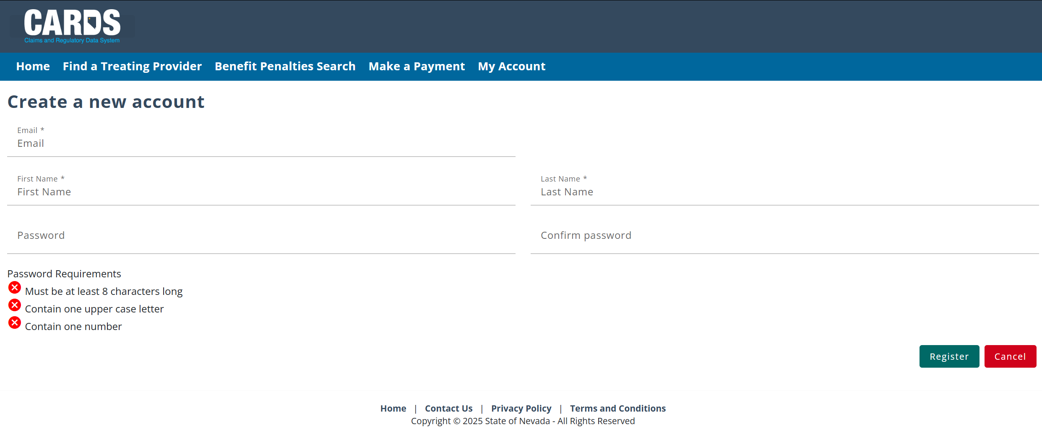
CARDS REGISTRATION
NAVIGATING TO THE CARDS WEBSITE AND COMPLETING ACCOUNT REGISTRATION
Step 3: Enter new log in information
Use the email you have on your Rating Panel application. If it is no longer available, let WCS know.

Slide 8
CARDS REGISTRATION
NAVIGATING TO THE CARDS WEBSITE AND COMPLETING ACCOUNT REGISTRATION
Step 4: Activate your account through the email link
Note: Email will be sent by “no-reply@nv.gov”

Slide 9
CARDS REGISTRATION
NAVIGATING TO THE CARDS WEBSITE AND COMPLETING ACCOUNT REGISTRATION
Step 5: Log into the CARDS site using the credentials provided at the time of registration

Slide 10
CARDS REGISTRATION
NAVIGATING TO THE CARDS WEBSITE AND COMPLETING ACCOUNT REGISTRATION
Step 6: Ensure your account is associated with an Entity*. If you have not been added to an entity group prior to activating your account, upon login, the homepage appear like the following:
*Entities are the parent account that external user can be linked under. CARDS has the following entity types:
Insurer
Third Party Administrator
Clinical Practitioner
Law Firm
Reach out to the account administrator of the entity you wish to join to be added to the group. The External Users module will review adding users and setting permissions for each user. If you are the administrator of the account and have not been added to the entity group, reach out to WCS (CARDS@dir.nv.gov or call 702-486-9080) to be added to your entity

Slide 11
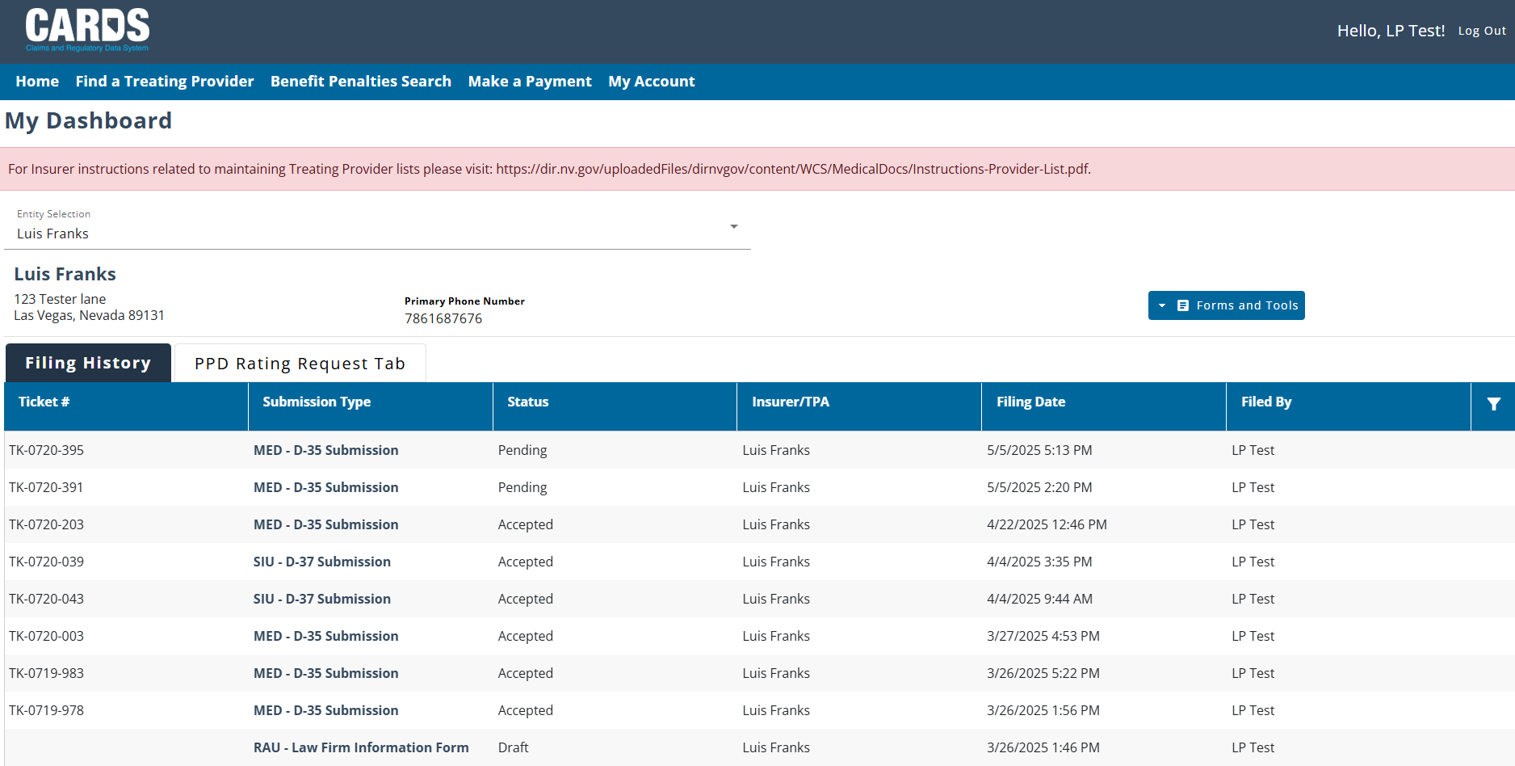
CARDS REGISTRATION
NAVIGATING TO THE CARDS WEBSITE AND COMPLETING ACCOUNT REGISTRATION
Once you are associated with an entity, the homepage will look as follows:
Depending on the type of entity you are related to (Insurer, TPA, Clinical Practitioner, Law Firm), the homepage will vary with what features are displayed. The External Users module will review some of these differences.

Slide 12
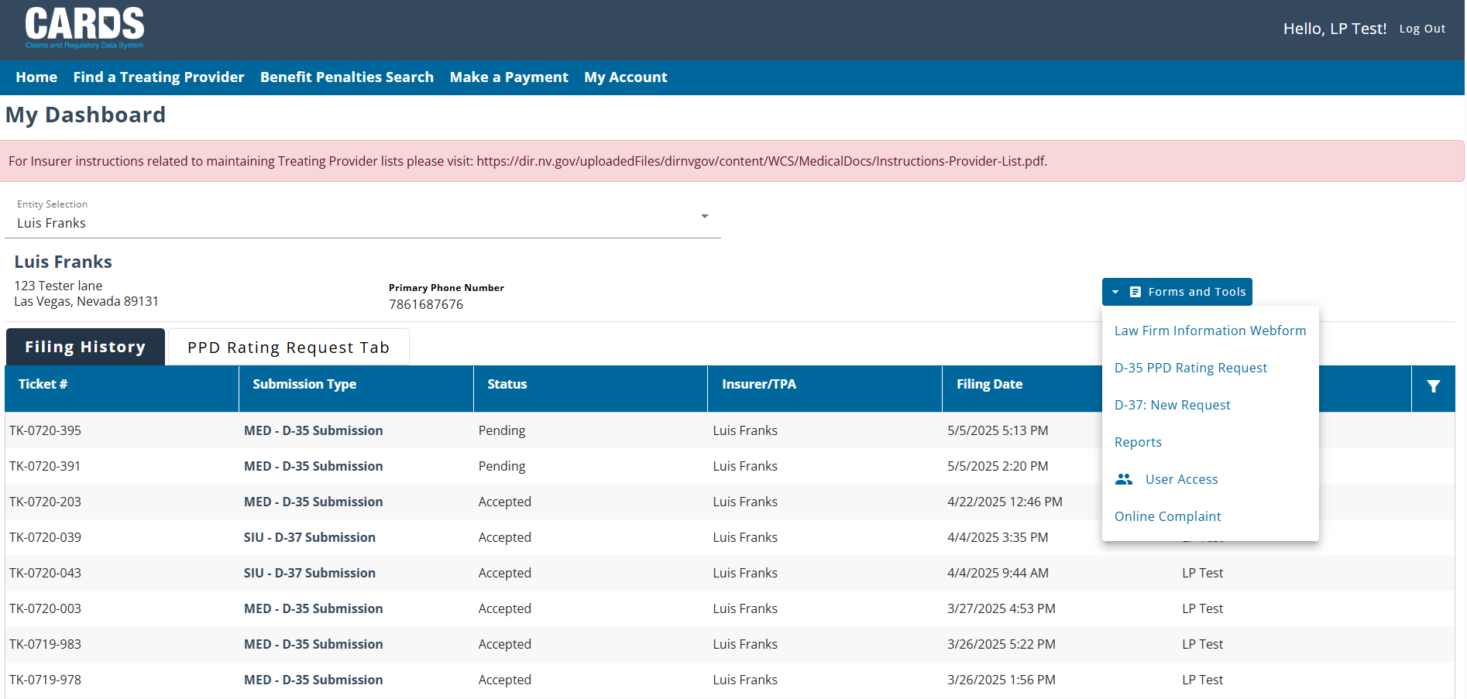
CARDS REGISTRATION
NAVIGATING TO THE CARDS WEBSITE AND COMPLETING ACCOUNT REGISTRATION

Slide 13
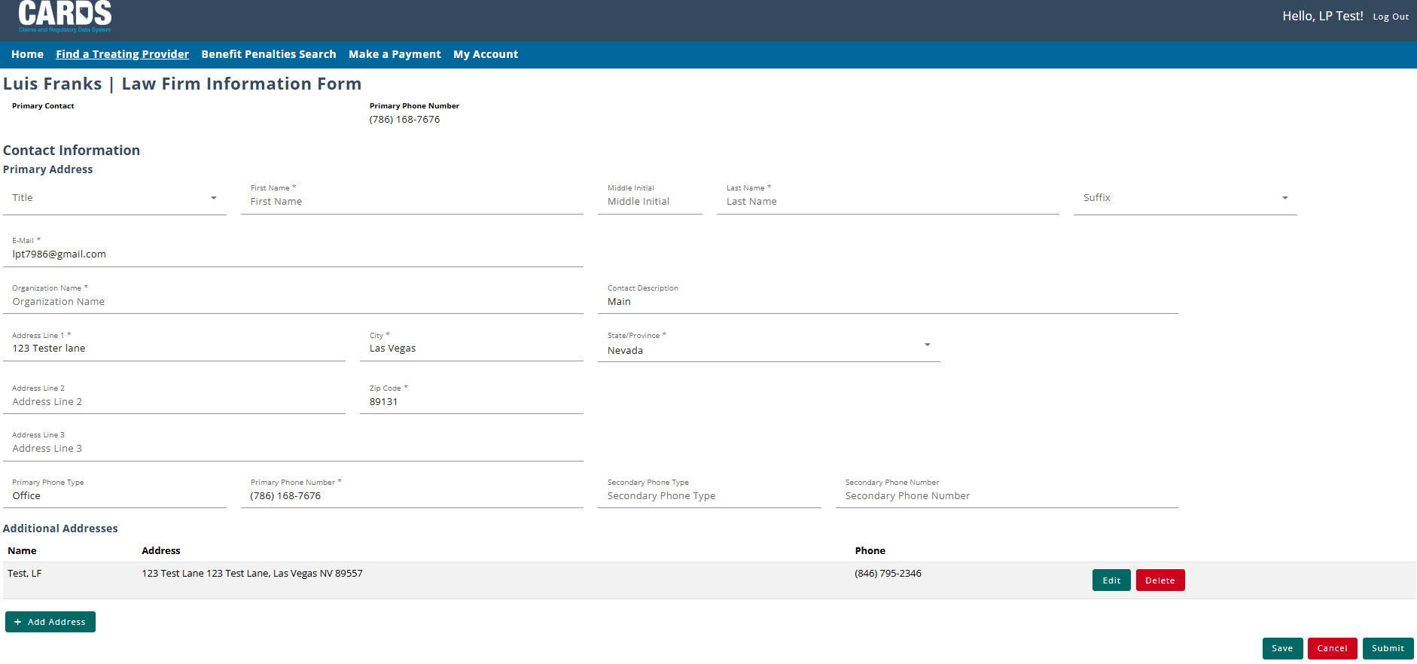
CARDS REGISTRATION
NAVIGATING TO THE CARDS WEBSITE AND COMPLETING ACCOUNT REGISTRATION
Provide all contact information and click Save or Submit.

Slide 14
CARDS REGISTRATION
NAVIGATING TO THE CARDS WEBSITE AND COMPLETING ACCOUNT REGISTRATION
This function is always visible on the menu bar, but only available to authenticated users.

Slide 15
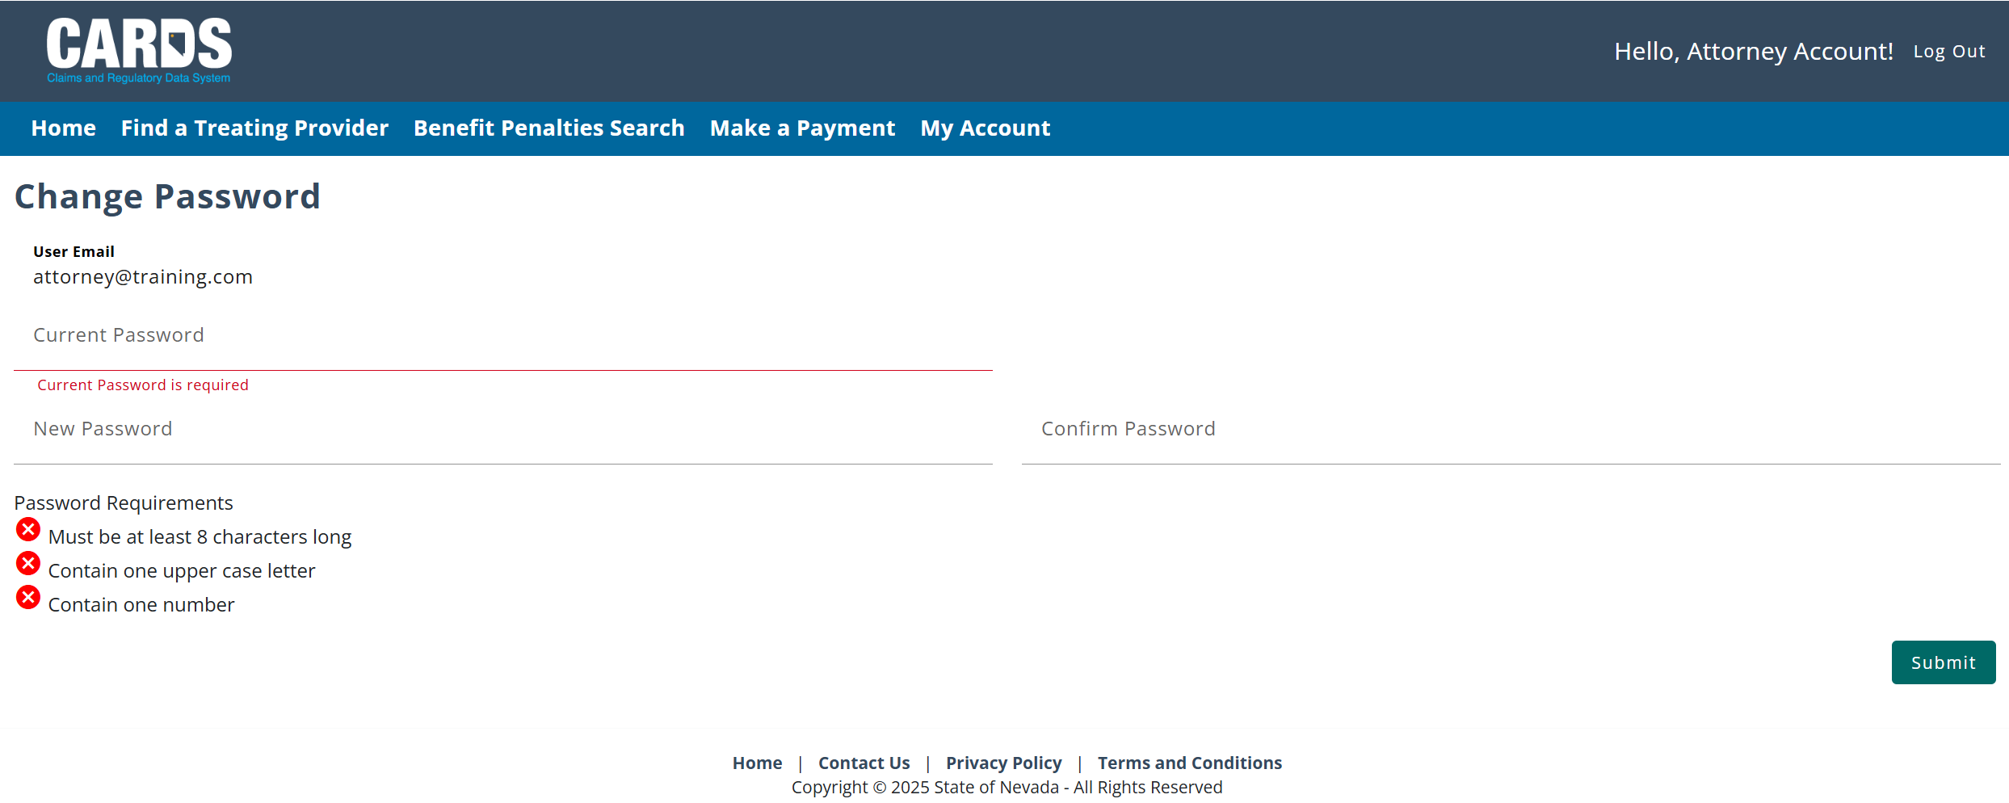
CARDS REGISTRATION
NAVIGATING TO THE CARDS WEBSITE AND COMPLETING ACCOUNT REGISTRATION
Resetting your password

Slide 16
USER TYPES
EXTERNAL USER TYPES IN THE CARDS APPLICATION

Slide 17
USER TYPES
EXTERNAL USER TYPES IN THE CARDS APPLICATION
Insurers: Already included as users in the CARDS application. Insurer users will be associated with at lease one Insurer entity and have may have a relationship to TPAs.
Third Party Administrators (TPAs): Already included as users in the CARDS application. TPA users will be associated to their TPA entity and can be granted permissions to perform actions on behalf of an Insurer.
Attorneys: New user type in the CARDS system. Attorneys are associated with a Law Firm entity, submitting forms on behalf of injured workers.
Clinical Practitioners: New user type in the CARDS system. Their entity will be the Clinical Practitioner Profile, they will be set up as admins and can have a few additional authenticated users on their account. Clinical practitioners will primarily use CARDS to submit evaluation forms for injured workers.

Slide 18
LAWYERS HOMEPAGE
EXTERNAL USER TYPES IN THE CARDS APPLICATION

Slide 19
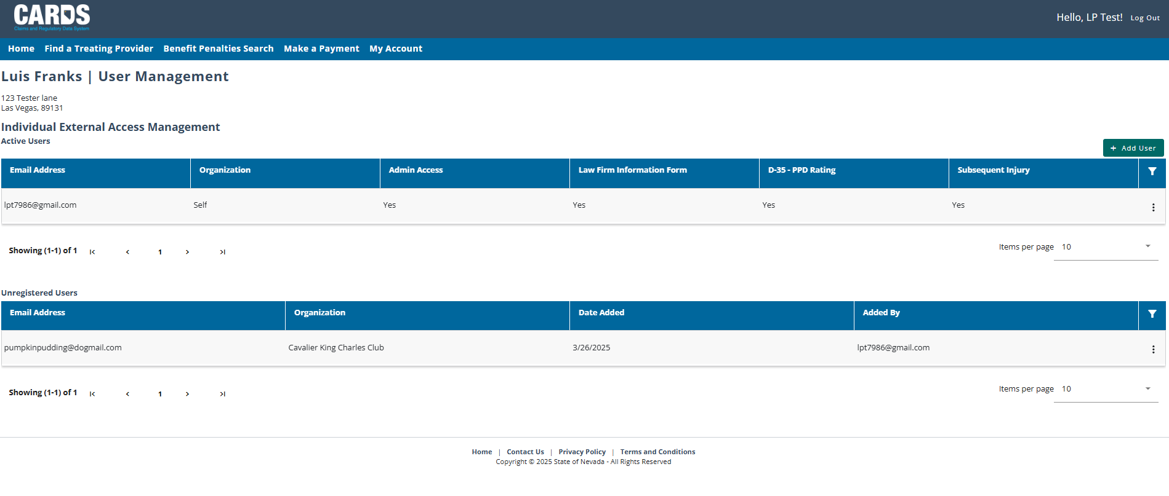
LAWYERS HOMEPAGE
EXTERNAL USER TYPES IN THE CARDS APPLICATION
Add Users as necessary.

Slide 20
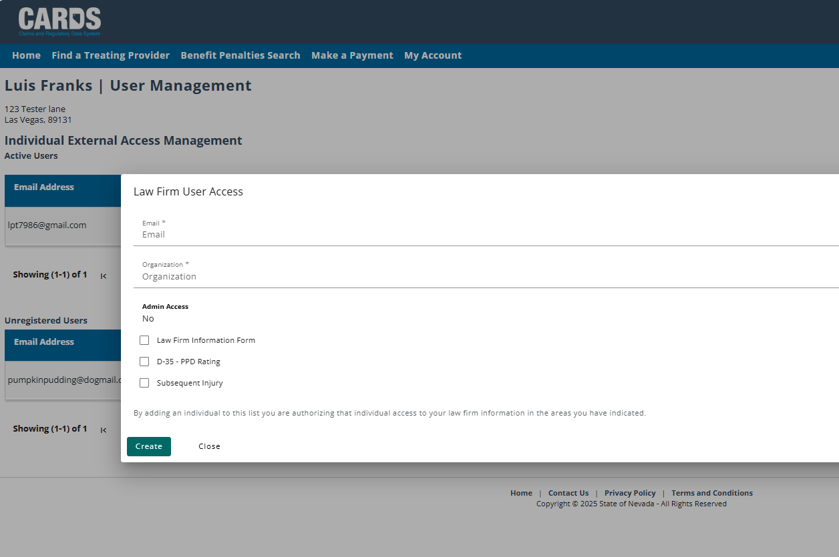
LAWYERS HOMEPAGE
EXTERNAL USER TYPES IN THE CARDS APPLICATION
Add Users and indicate Access Type

Slide 21
User Permissions and the Role of an Account Admin
ACCESSING CARDS FUNCTIONS BY ROLE

Slide 22
USER PERMISSIONS
ACCOUNT ADMINS FOR ENTITY GROUPS
Each Entity group will have a designated admin user who will be responsible for setting permissions for each user that is added to the group. Admins can only be set up by the internal WCS staff, which will be done when the Entity is added to the CARDS application.

Slide 23
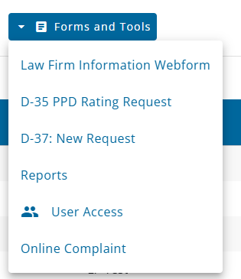
USER PERMISSIONS
ACCOUNT ADMINS FOR ENTITY GROUPS
Setting user permissions allows account admin to control what CARDS functions individual accounts can access based on their role. Permissions can be set or updated from the User Access accessible through the Forms and Tools menu on the homepage.
*
*D-37 training is covered under a separate training module from Insurer Compliance Unit

Slide 24
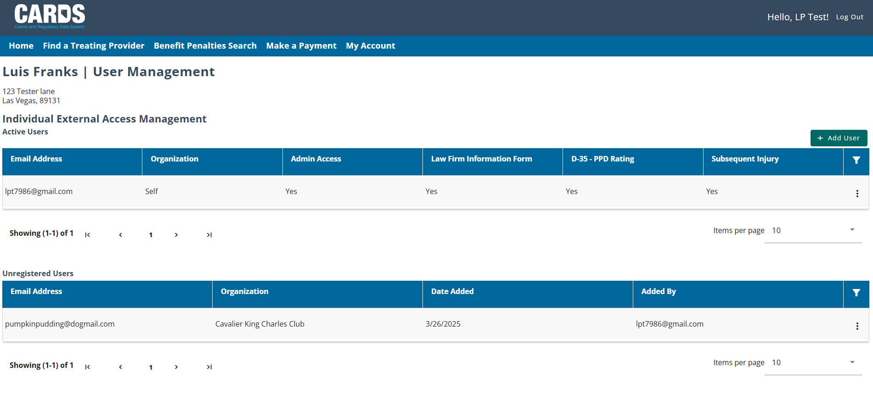
USER PERMISSIONS
ACCOUNT ADMINS FOR ENTITY GROUPS

Slide 26
CARDS NAVIGATION
GENERAL NAVIGATION IN THE CARDS APPLICATION

Slide 27
CARDS NAVIGATION
FILING HISTORY TAB

Slide 28
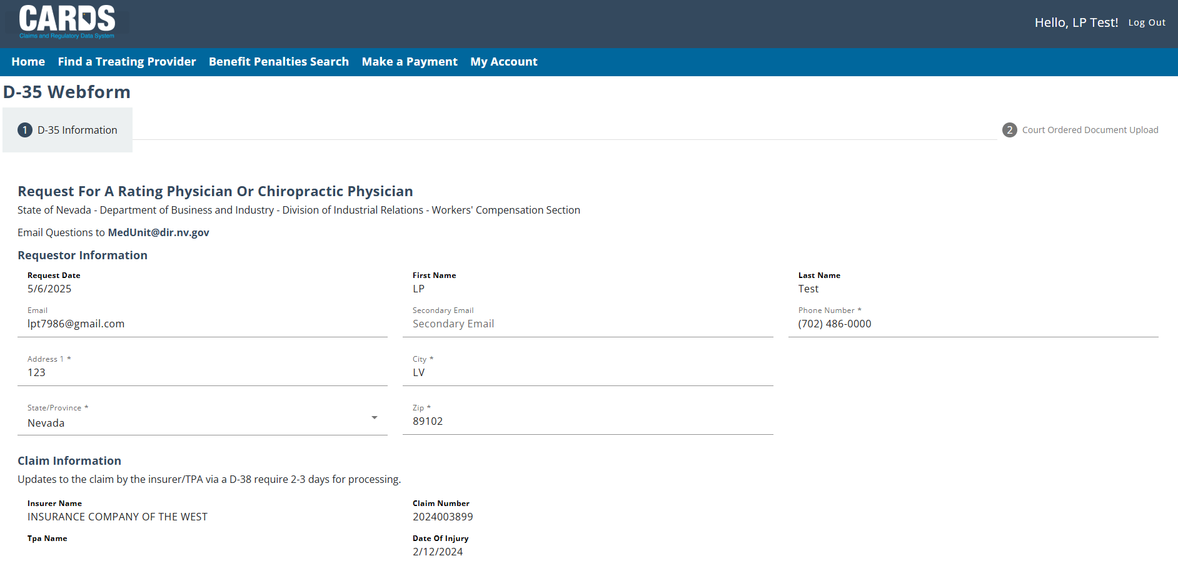
CARDS NAVIGATION
D-35 WEBFORM

Slide 29
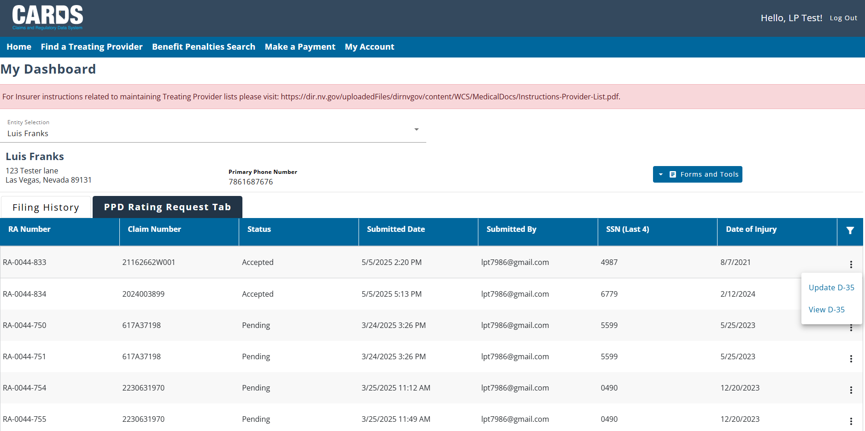
CARDS NAVIGATION
PPD RATING REQUEST TAB

Slide 30
CARDS NAVIGATION
D-35 WEBFORM

Slide 31
CARDS NAVIGATION
FILING AN ONLINE COMPLAINT

Slide 32
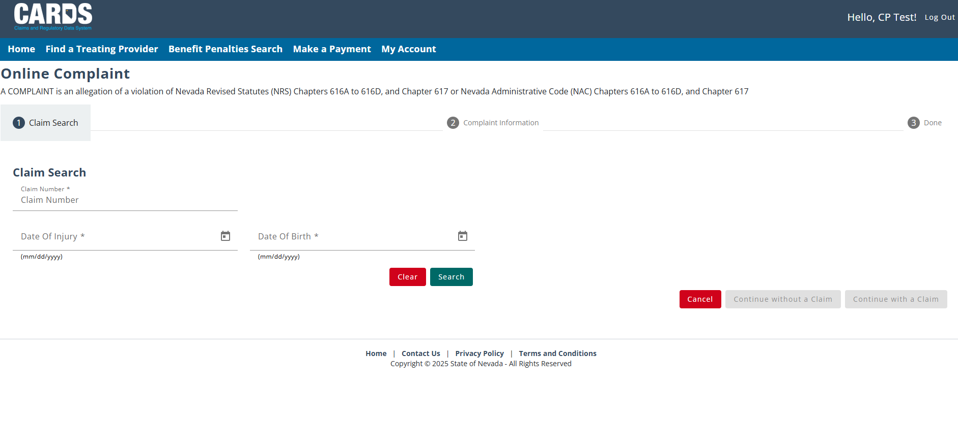
CARDS NAVIGATION
GENERAL NAVIGATION IN THE CARDS APPLICATION
Note: Put information on these prompts if you know the required data. If not, put bogus information so that the “Continue without a Claim” will be an option. Hit Search then click on “Continue without a Claim”.

Slide 33
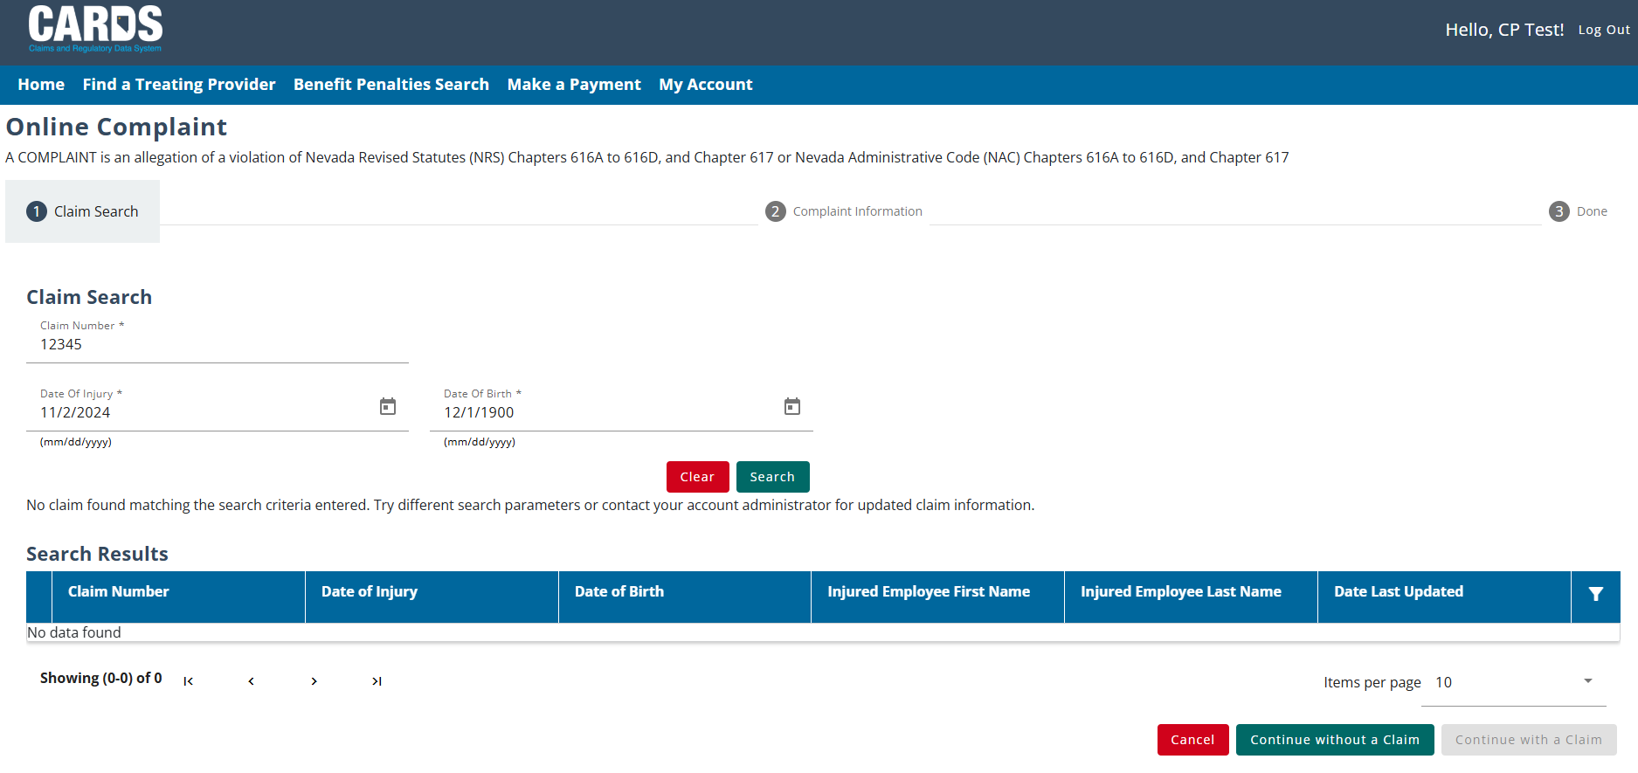
CARDS NAVIGATION
GENERAL NAVIGATION IN THE CARDS APPLICATION

Slide 34
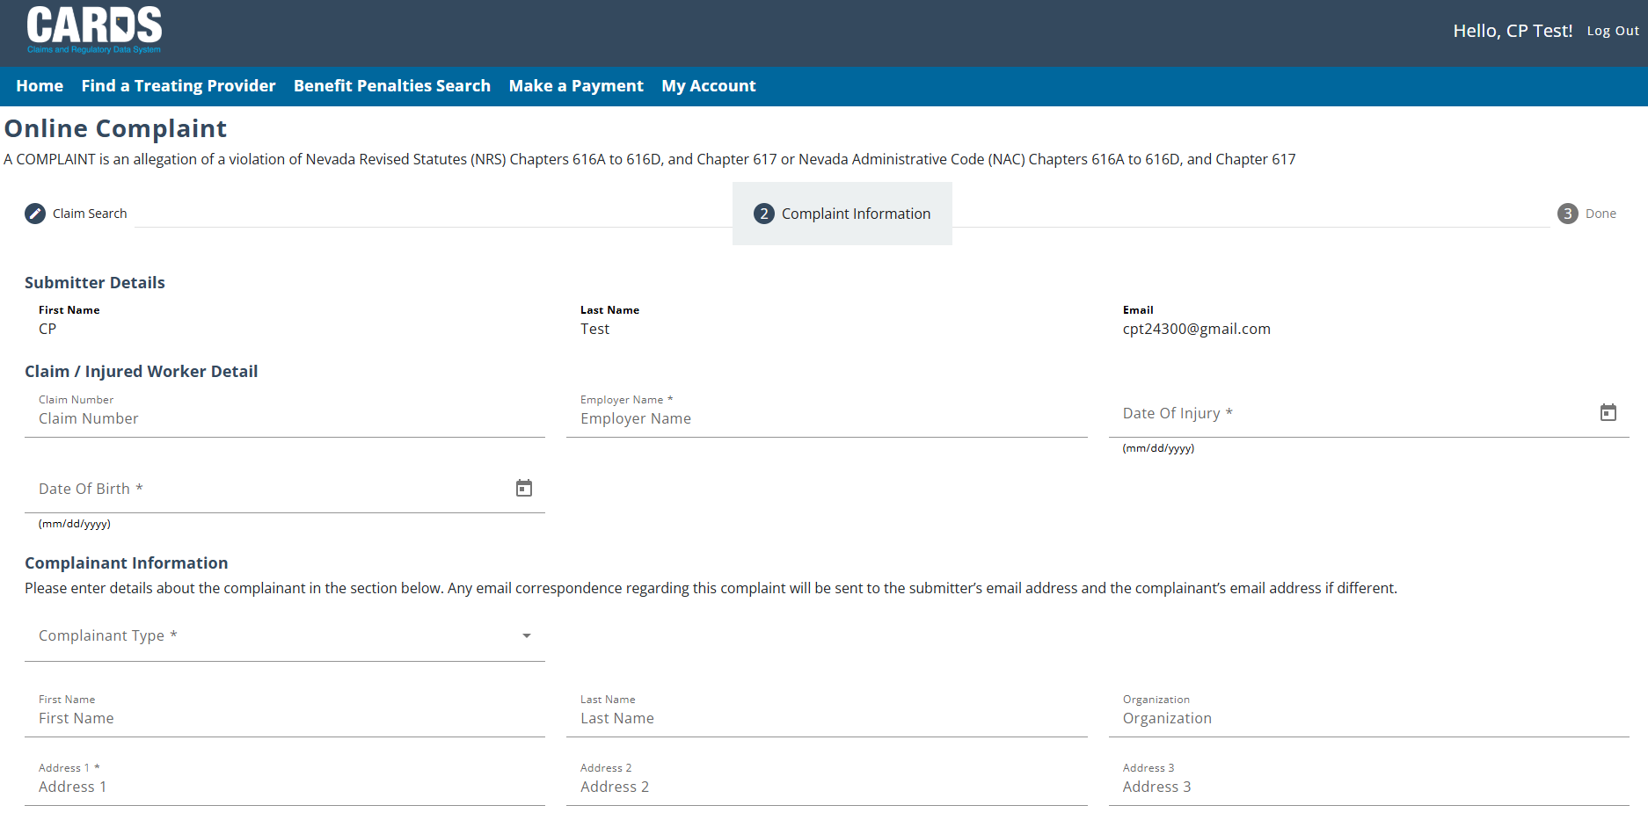
CARDS NAVIGATION
GENERAL NAVIGATION IN THE CARDS APPLICATION
Fill out the online form

Slide 35
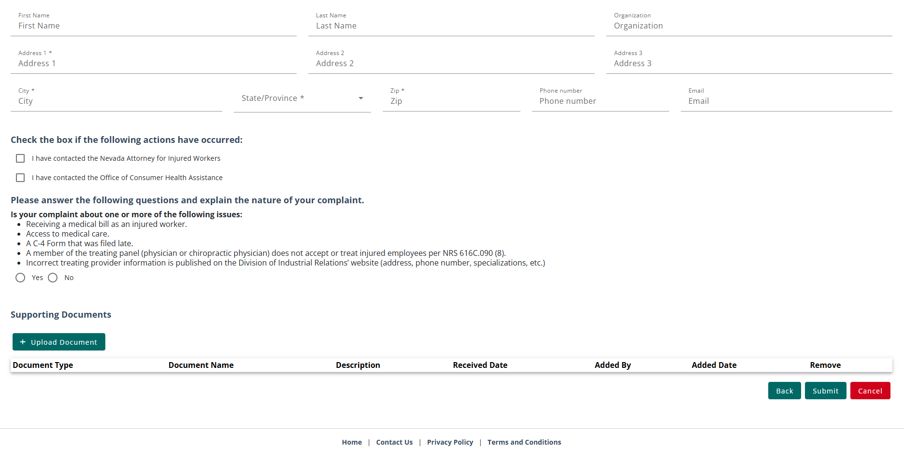
CARDS NAVIGATION
GENERAL NAVIGATION IN THE CARDS APPLICATION
Fill out the online form then hit Submit
Upload documents as necessary

Slide 36
FILING A D-35 WEBFORM
FILING A D-35 REQUEST FOR AUTHENTICATED USERS

Slide 37
INSURER/TPA OR INJURED WORKER/REP SUBMITS A REQUEST FOR RATER USING THE D-35 FORM WEBFORM TO WCS
WCS PROCESS THE D-35 AND ASSIGNS THE PPD RATING TO A RATER
RATER ACCEPTS OR DECLINES THE ASSIGNMENT
IF ACCEPTED, RATER PERFORMS PPD EVALUATION
The claim needs to be “Indexed” first in our CARDS system before a Request for a Rater is processed by WCS.

Slide 38
FILING A D-35 WEBFORM
FILING A D-35 REQUEST FOR AUTHENTICATED USERS

Slide 39
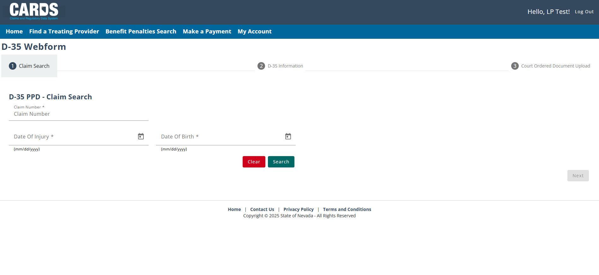
FILING A D-35 WEBFORM
PART 1 : CLAIM SEARCH
Fill out the information needed then hit Search.

Slide 40
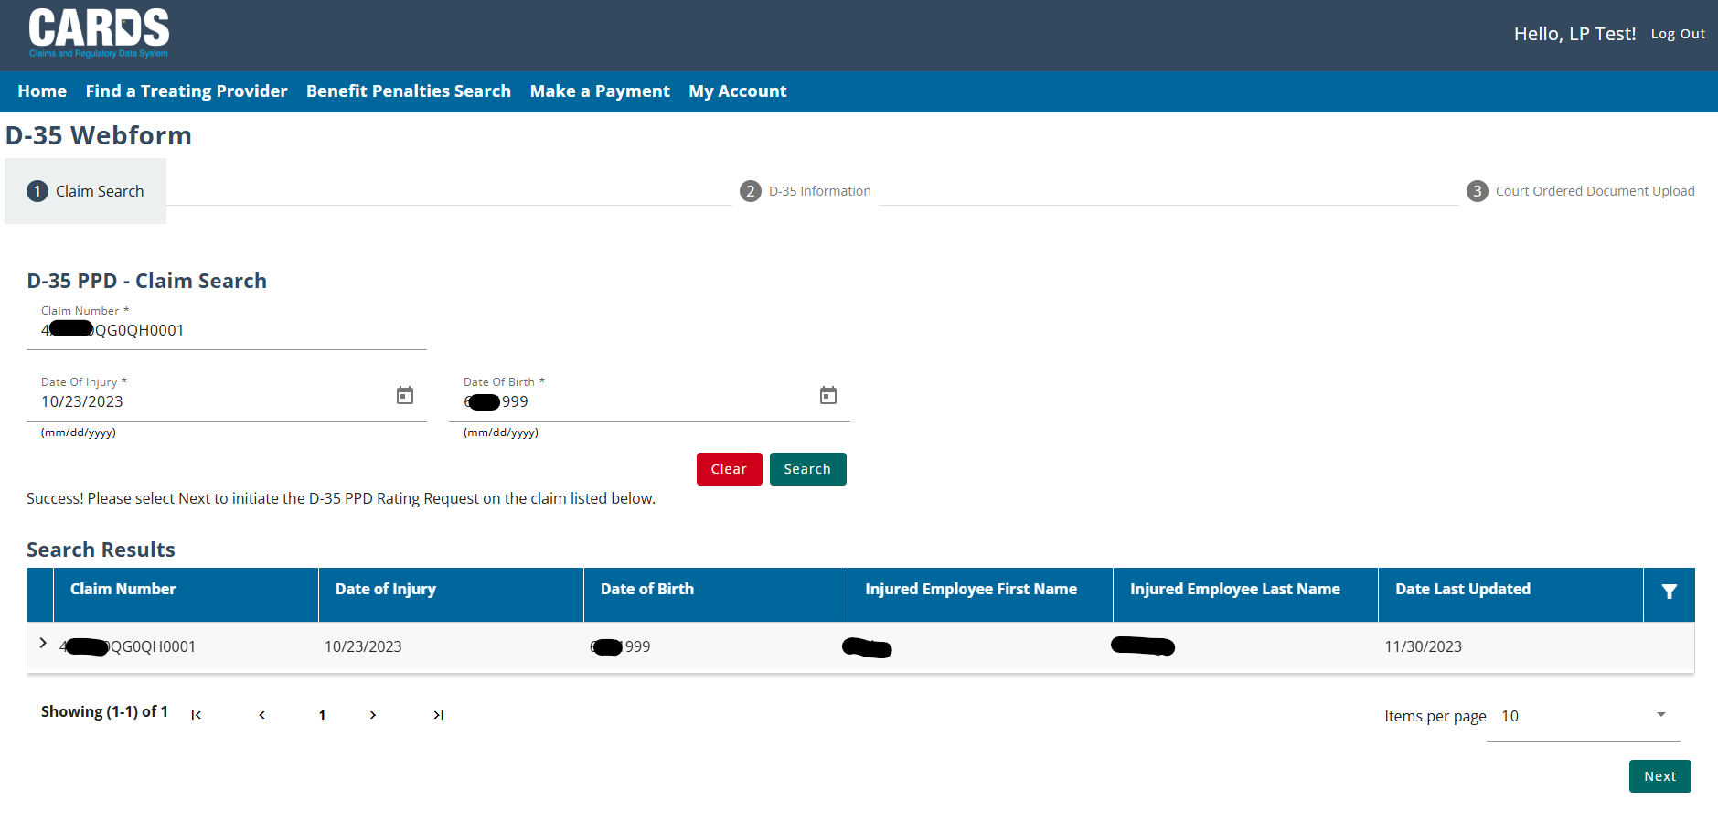
FILING A D-35 WEBFORM
FILING A D-35 REQUEST FOR AUTHENTICATED USERS
Once you found the claim, hit Next.

Slide 41
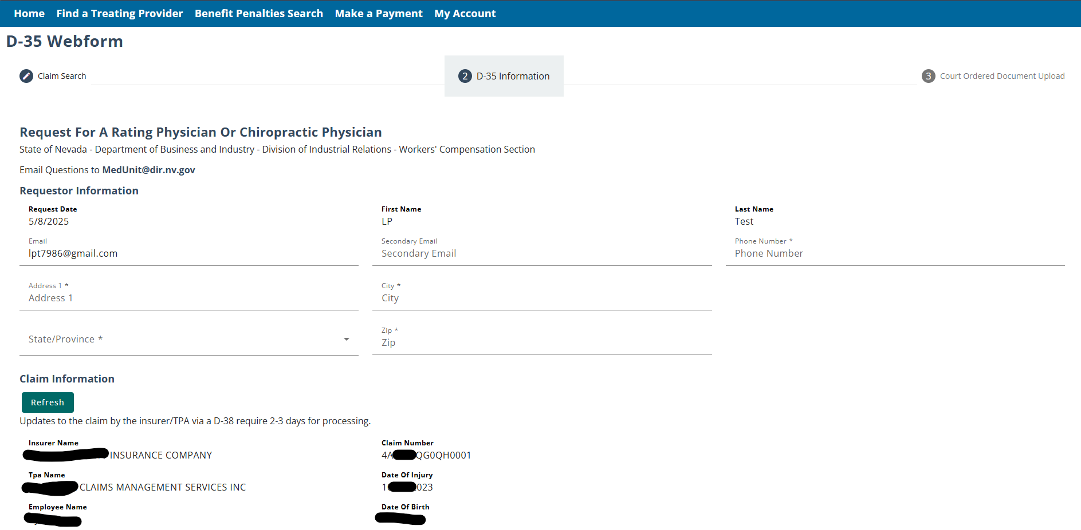
FILING A D-35 WEBFORM
PART 2 : D-35 INFORMATION

Slide 42
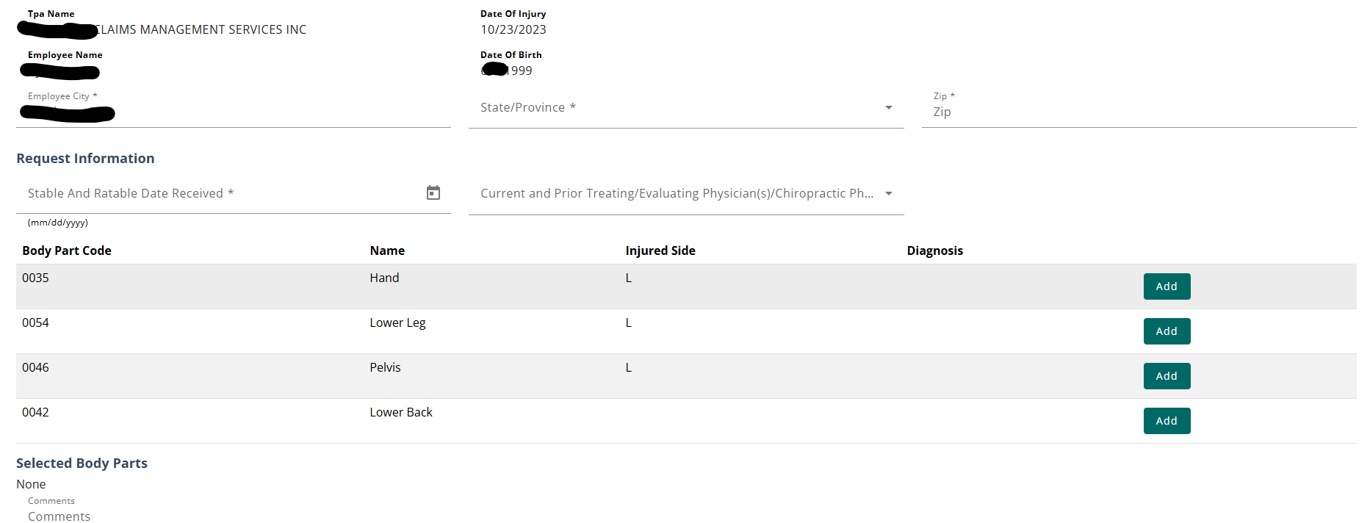
FILING A D-35 WEBFORM
PART 2 : D-35 INFORMATION – BODY PARTS
The body parts that can be selected on the webform must come from an approved claim and must be accepted on the claim. Select the body part and add the diagnosis for each body part selected.

Slide 43
FILING A D-35 WEBFORM
PART 2 : D-35 INFORMATION – COURT ORDERED
If the PPD rating request has been court ordered, it must be indicated on the D-35. In part 3 of the form, the user will be able to submit any documentation pertaining to the court order. In the case of a court ordered request, you will have the ability to select a rating physician from the available raters if they had been selected from the court order.

Slide 44
FILING A D-35 WEBFORM
PART 2 : D-35 INFORMATION – COURT ORDERED DOCUMENT UPLOAD
If the requestor has indicated that the PPD request is court ordered, they must upload all relevant documentation before submitting the D-35 webform. For PPD requests that are not court ordered, requestors will be able to submit after Part 2.

Slide 45
FILING A D-35 WEBFORM
PART 2 : D-35 INFORMATION – MUTUAL AGREEMENT
If a user has a mutual agreement with a rating physician that is willing to conduct the PPD rating requested, they can select the middle check box at the bottom of the form and fill out the information about the agreement. The rating physician must be selected in the case of a Mutual agreement, and additional fields will populate based on the selection.

Slide 46
FILING A D-35 WEBFORM
PART 2 : D-35 INFORMATION – PREVIOUS PPD EVALUATION
If this is not the first PPD evaluation process that has been initiated on the selected claim, the name of the rating physician and the reason for a new request must be provided. A rater can not be assigned to a request if they had conducted a previous PPD rating, unless the rating is related to a body part that has not previously been rated.

Slide 47
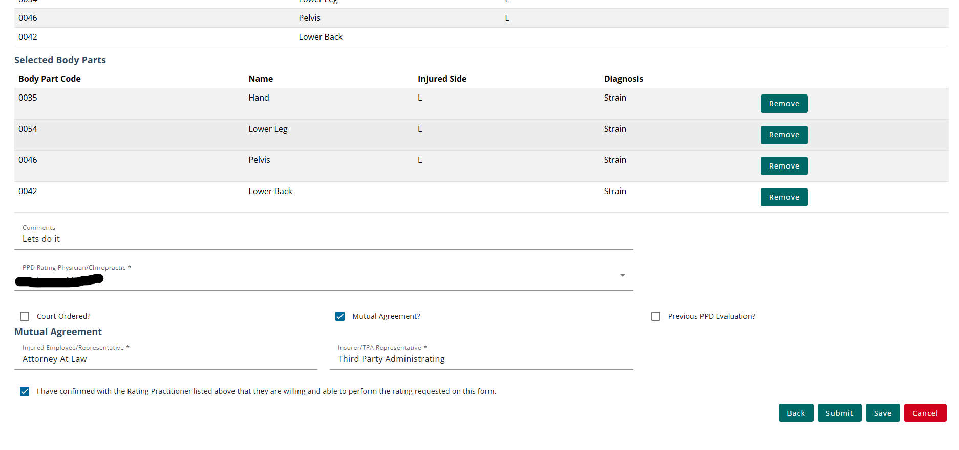
FILING A D-35 WEBFORM
FILING A D-35 REQUEST FOR AUTHENTICATED USERS
After all the required fields have been filled in, users can submit the webform. After pressing the submit button, a modal will pop up to confirm the submission. After pressing submit in the modal, users will be taken back to the dashboard and shown a success message. The submission can be viewed on the Filing History tab.

Slide 48
FILING A D-35 WEBFORM
CORRECTING THE D-35 WEBFORM
If the Med Unit finds any errors in a D-35 submission, they can send the webform back to the requestor for corrections. If your D-35 submission needs corrections, you will receive an email notification with instructions when it needs to be updated. Note: This may mean that there is information that you need to go back and update on the original claim (D-38) form as well.
The webforms that require corrections can be found in the Filing History tab and will show the “Corrections Required” status. The form can be opened from the link in the Submission Type column to correct any necessary information.

Slide 49
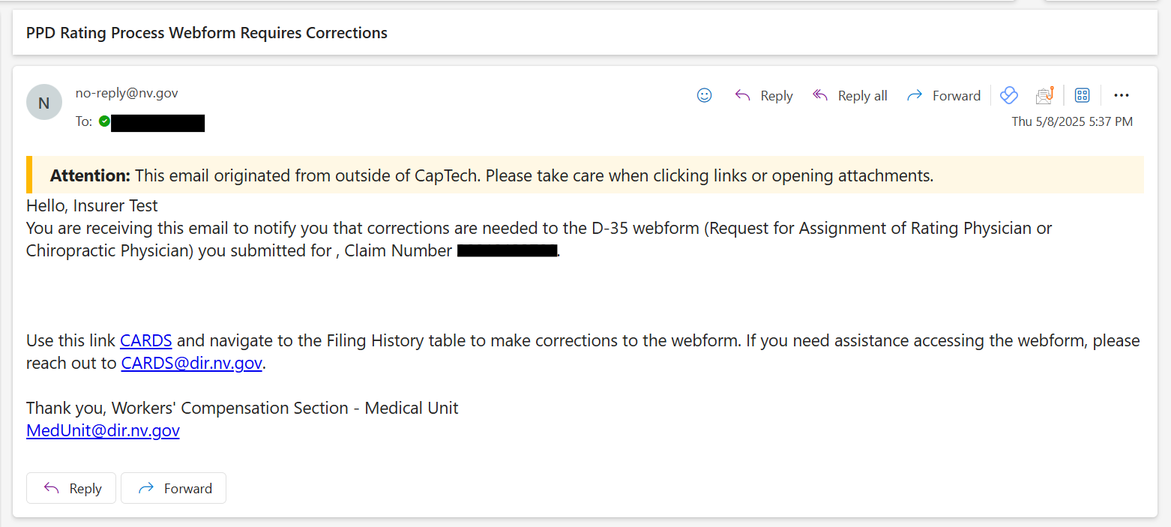
FILING A D-35 WEBFORM
D-35 CORRECTIONS REQUIRED EMAIL NOTIFICATION
The correction notification email will include a link for you navigate into CARDS to view the corrections needed to the D-35 webform.

Slide 50
FILING A D-35 WEBFORM
ACCEPTED D-35 WEBFORM
Once the webform has been accepted by the internal Med Unit, the status of the webform will update to “Accepted” and the generated PPD Rating Request will populate in the PPD Rating Tab. At this point, the rating physician has been assigned.

Slide 51
KNOWLEDGE CHECK

Slide 52
RATING ASSIGNMENT

Slide 53
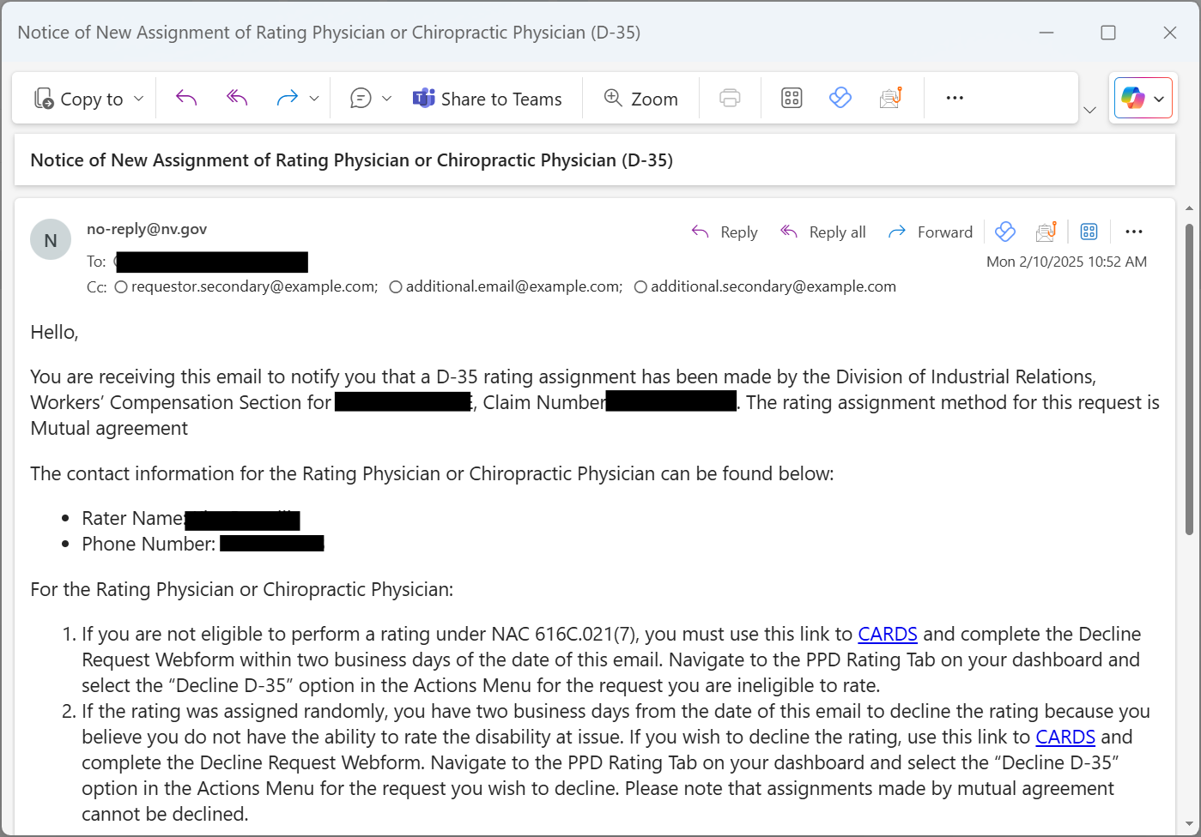
RATING ASSIGNMENT
When an assignment has occurred on the request, the submitter of the form and the assigned physician will be notified via email of the assignment. The contact information of the physician will be provided in the email. The email will include a PDF version of the submitted data from CARDS in the template shown below.

Slide 54
PPD RATING REQUEST STATUS
When an assignment has occurred on the request, request will remain in the “Pending” status until the physician choses to either decline a request, mark themselves as ineligible to perform the request, or two days have elapsed since the assignment. Once the two days have elapsed, the request will be accepted, and the rating appointment can be completed

Slide 55
DECLINED/ INELIGIBLE REQUESTS
If the assigned rating physician chooses to decline a request or mark them as ineligible to perform the rating, the status of the request will update to reflect the action taken. You will have the ability to update the rating for a new assignment or a random assignment will occur automatically after 6 days.

Slide 56
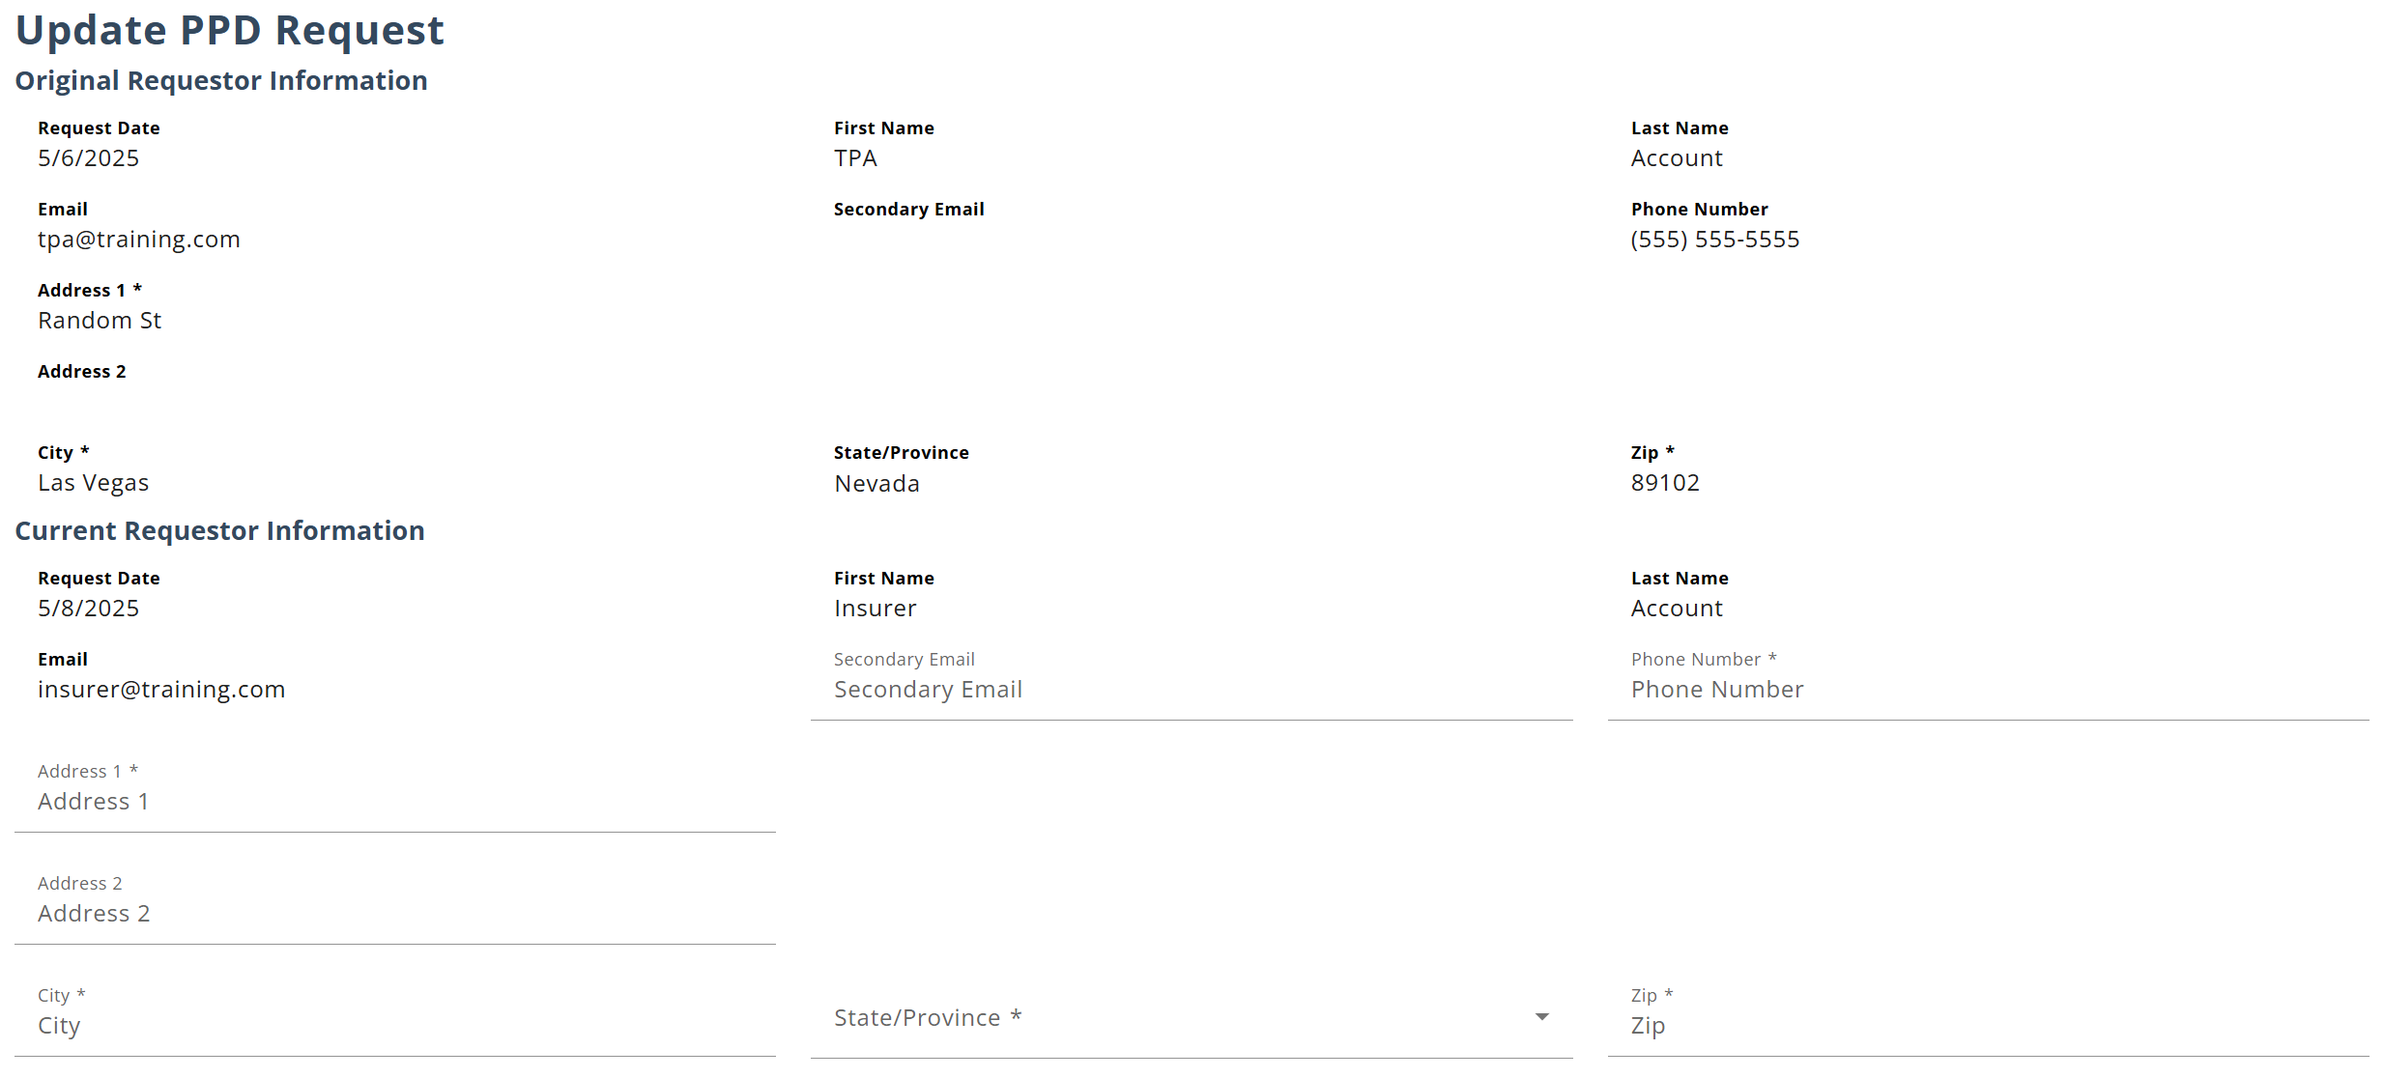
DECLINED/ INELIGIBLE REQUESTS
Once a request has been declined, you are able to reopen the D-35 webform to submit updates. Updates can also be made prior to the acceptance of the request from the physician if there are any changes to the request.

Slide 57
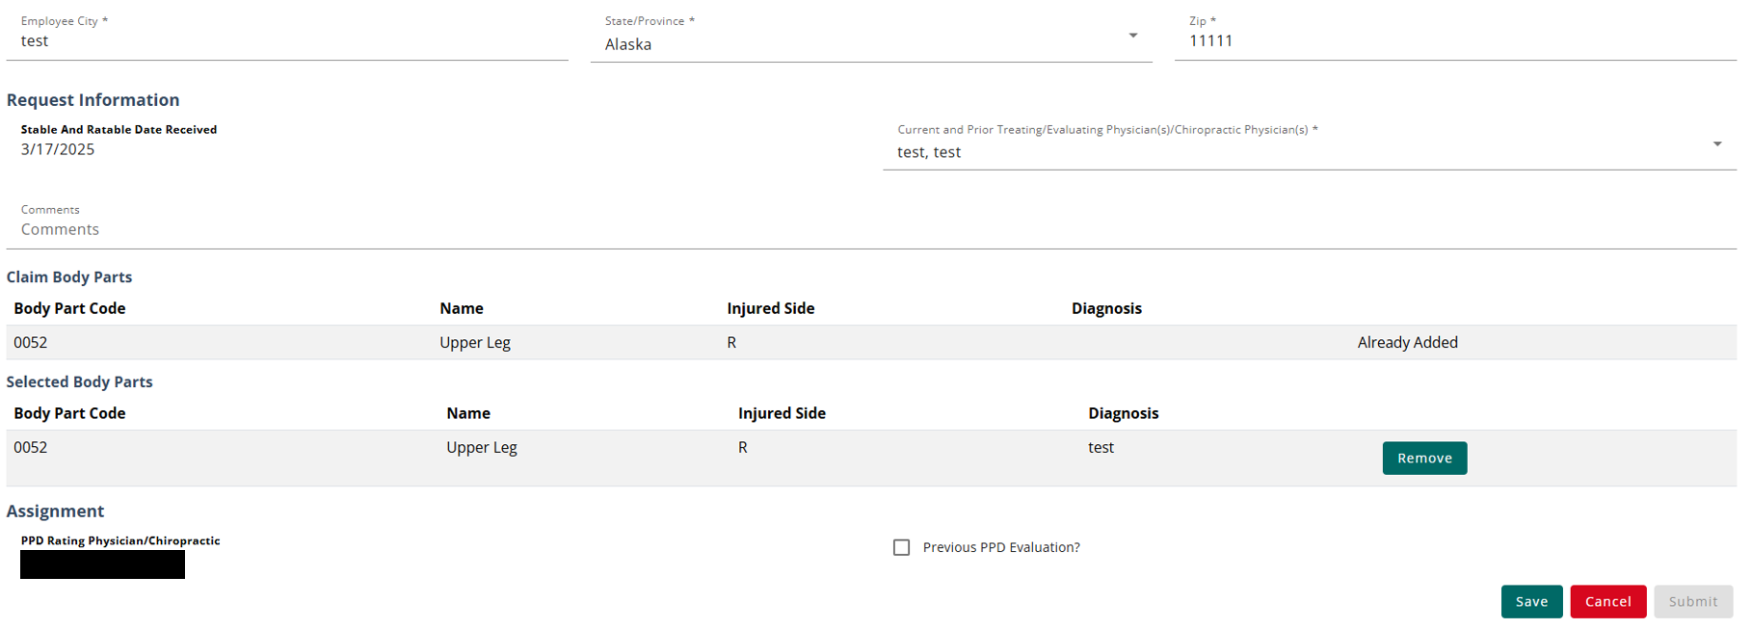
UPDATED D-3 WEBFORM
The update form only allows certain details to be updated, such as the injured employee information and updates to the selected body parts. The rating physician can only be updated if the rater declined the request or marked themselves as ineligible. If a general update is made, the rater will remain on the request.

Slide 58
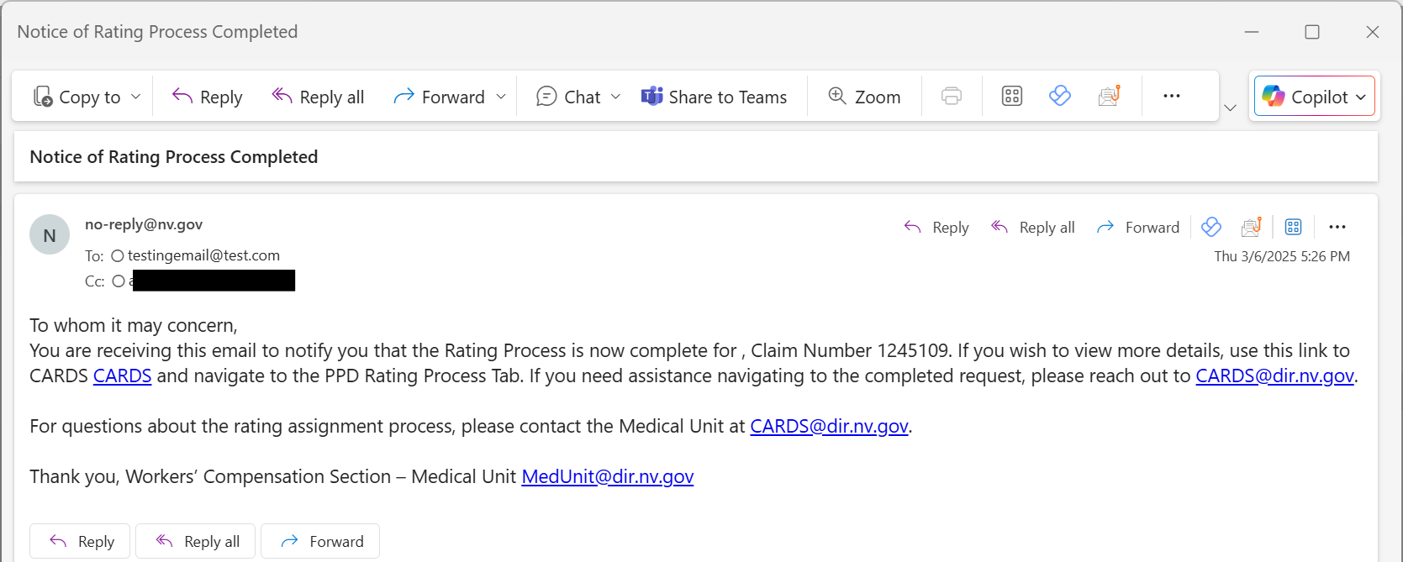
COMPLETING THE RATING PROCESS
The rating process is complete once the rating has been submitted. An email will be sent to all involved parties including the requestor, the clinical practitioner, and any additional emails provided in the PPD transaction.

Slide 59
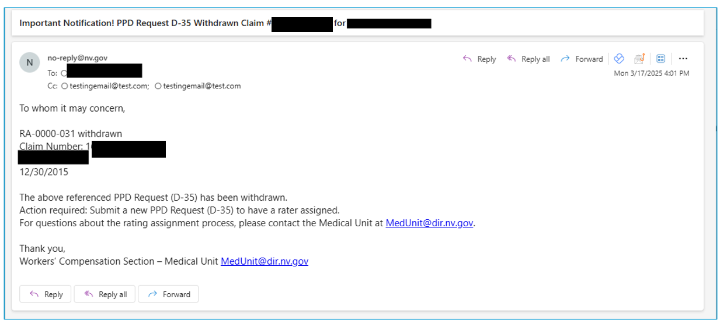
WITHDRAWN REQUESTS
When a request is withdrawn, an email will be sent to all involved parties including the requestor, the clinical practitioner, and any additional emails provided in the PPD transaction. No additional action can be taken once a request is withdrawn.

Slide 60
COMPLAINT WEBFORM
FILING A COMPLAINT FOR NON-AUTHENTICATED USERS

Slide 61
COMPLAINT WEBFORM
FILING A COMPLAINT IN CARDS FOR NON-AUTHENTICATED USERS
One of the new features of CARDS is the ability to file an online complaint. The form will gather basic information about the complainant and the details of the complaint, as well as asking a series of questions to determine the nature of the compliant. Once the complaint form is submitted, it will be routed to the proper department to be worked depending on what the complaint relates to.
There are two complaint forms available within CARDS. For users with CARDS accounts, the complaint form is accessible using their Forms and Tools menu. For others who do not have an account, there is a publicly available complaint form located in the navigation ribbon on the log in page.
Users will be provided with a Complaint confirmation number that can be used for any future communications with the investigator assigned to the complaint.

Slide 62
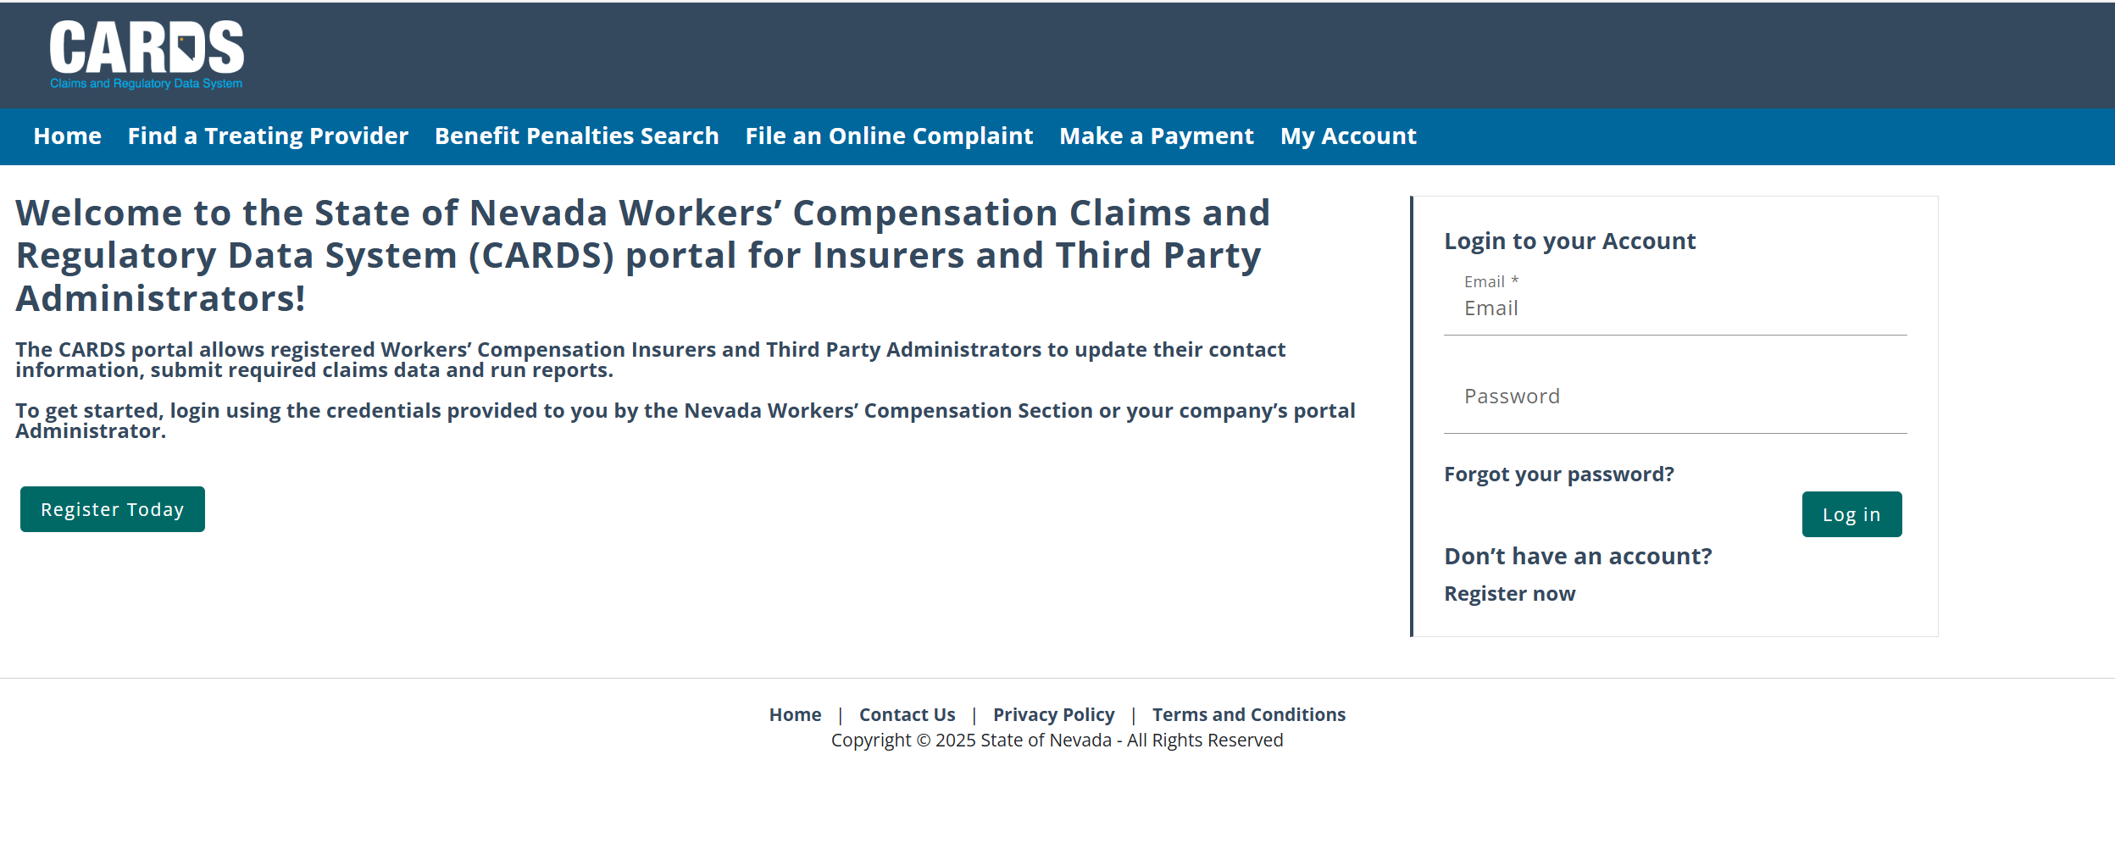
COMPLAINT WEBFORM
FILING A COMPLAINT IN CARDS FOR NON-AUTHENTICATED USERS

Slide 63
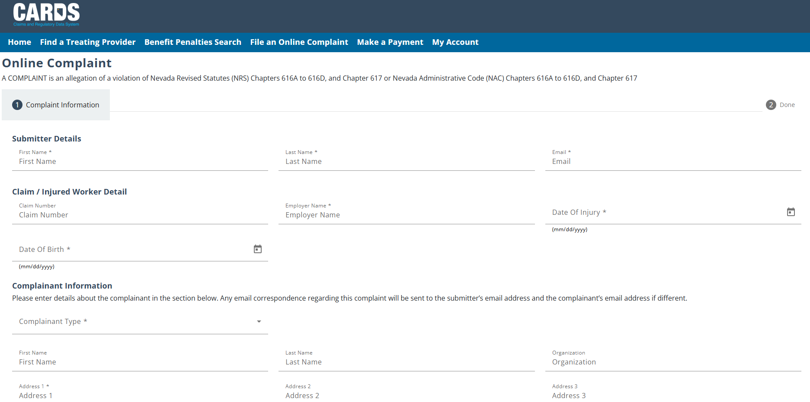
COMPLAINT WEBFORM
FILING A COMPLAINT IN CARDS FOR NON-AUTHENTICATED USERS

Slide 64
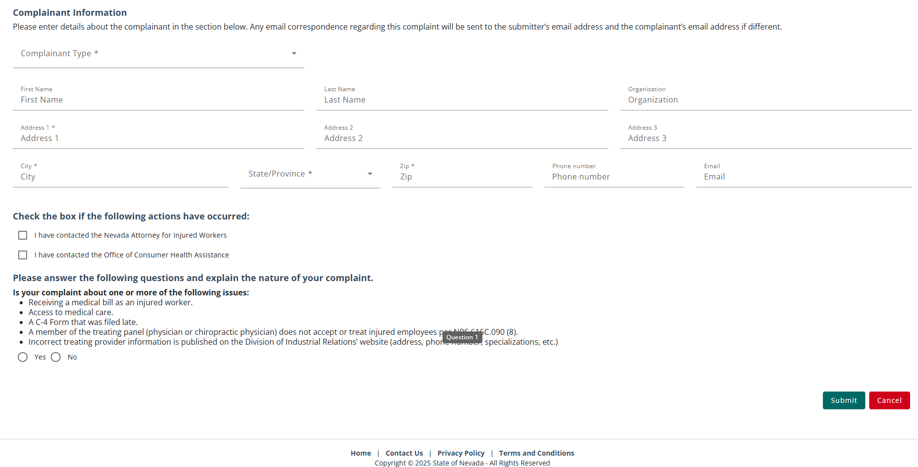
COMPLAINT WEBFORM
FILING A COMPLAINT IN CARDS FOR NON-AUTHENTICATED USERS
Provide all the necessary information then hit Submit.

Slide 65
WCS INVESTIGATION TIMELINE
FILING A COMPLAINT IN CARDS FOR NON-AUTHENTICATED USERS
NRS 616D.130 Investigation of alleged violation; determination of Administrator.
1. Upon receipt of a complaint for a violation of subsection 1, 2 or 3 of NRS 616D.120, or if the Administrator has reason to believe that such a violation has occurred, the Administrator shall:
(a) Promptly provide a copy of the complaint, or an explanation of the reason the Administrator believes that a violation has occurred to:
(1) The Commissioner; and
(2) The insurer, organization for managed care, health care provider, third-party administrator, employer or professional employer organization that allegedly committed the violation; and
(b) Cause to be conducted an investigation of the alleged violation.
2. The Administrator shall:
(a) Within 30 days after receipt of a complaint pursuant to subsection 1, initiate an investigation;
(b) Within 60 days after the date on which the investigation is initiated, complete the investigation; and
(c) Within 30 days after the investigation is completed, render a determination and deliver a copy of the determination to:
(1) The Commissioner; and
(2) The insurer, organization for managed care, health care provider, third-party administrator, employer or professional employer organization that was the subject of the investigation.

Slide 66
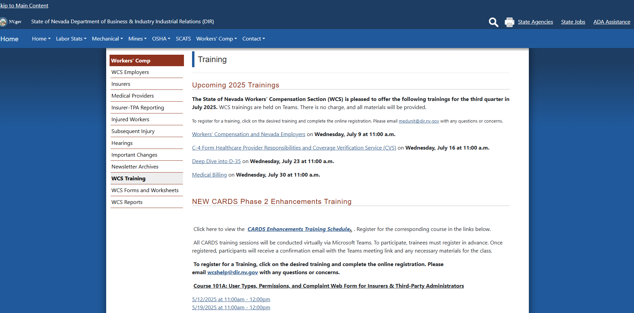
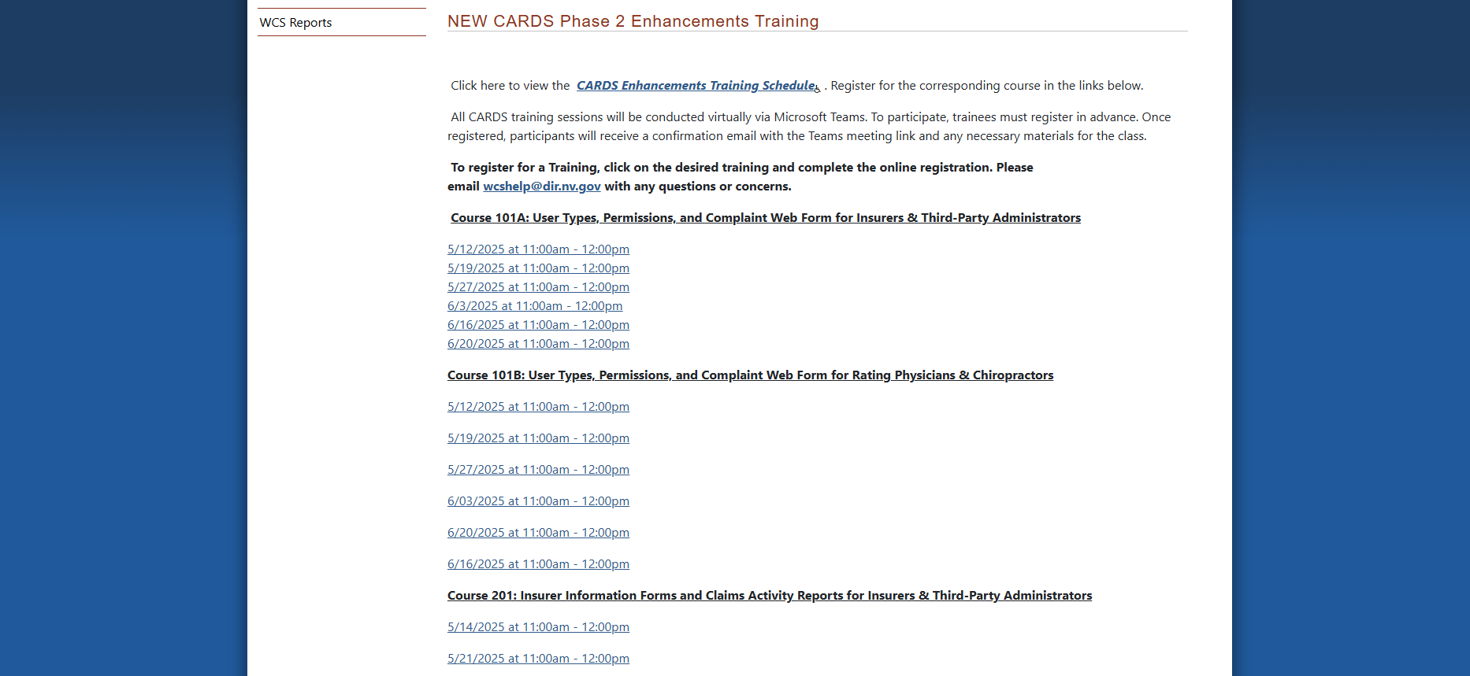
WHAT’S NEXT?

Slide 67
QUESTIONS?

Slide 68
THANK YOU

